Slide 1




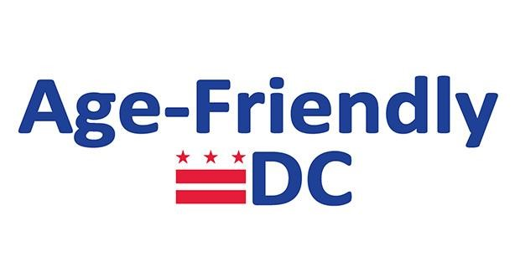


Senior Food Access in the Time of COVID
A Webinar on Federal and D.C. Food Programs for Older Adults
June 24, 2020

Slide 2
Welcome & overview
We have muted everyone on entry to the webinar; please stay muted if not speaking.
The webinar will be recorded and sent out after the webinar.
We will have about 15 minutes for questions. Please type questions in the chat throughout the webinar.
If you run into technical difficulties, please notify us in the chat or email Nomi at nsmall@frac.org.

Slide 3
First of all, thank you!
Thank you for all that you have been doing to support older adults during COVID-19.
You play an important role in getting information to seniors and helping spread information about these programs.
We know that the need for food and other support has increased during this public health emergency, and your work will continue to be critical to supporting seniors moving forward.

Slide 4
Goal of the webinar
This webinar will provide important updates on federal and local food programs and share information on how eligible seniors can apply and participate in these programs.
This webinar is aimed at organizations who directly support District older adults.
This webinar is a high-level overview of several programs, and we will provide contact information if you want to learn more about specific programs.

Slide 5
Programs covered during this webinar
Supplemental Nutrition Assistance Program (SNAP)
Federal Stimulus Checks
Senior Meals
Grocery Distribution
Other food resources available during COVID-19

Slide 6
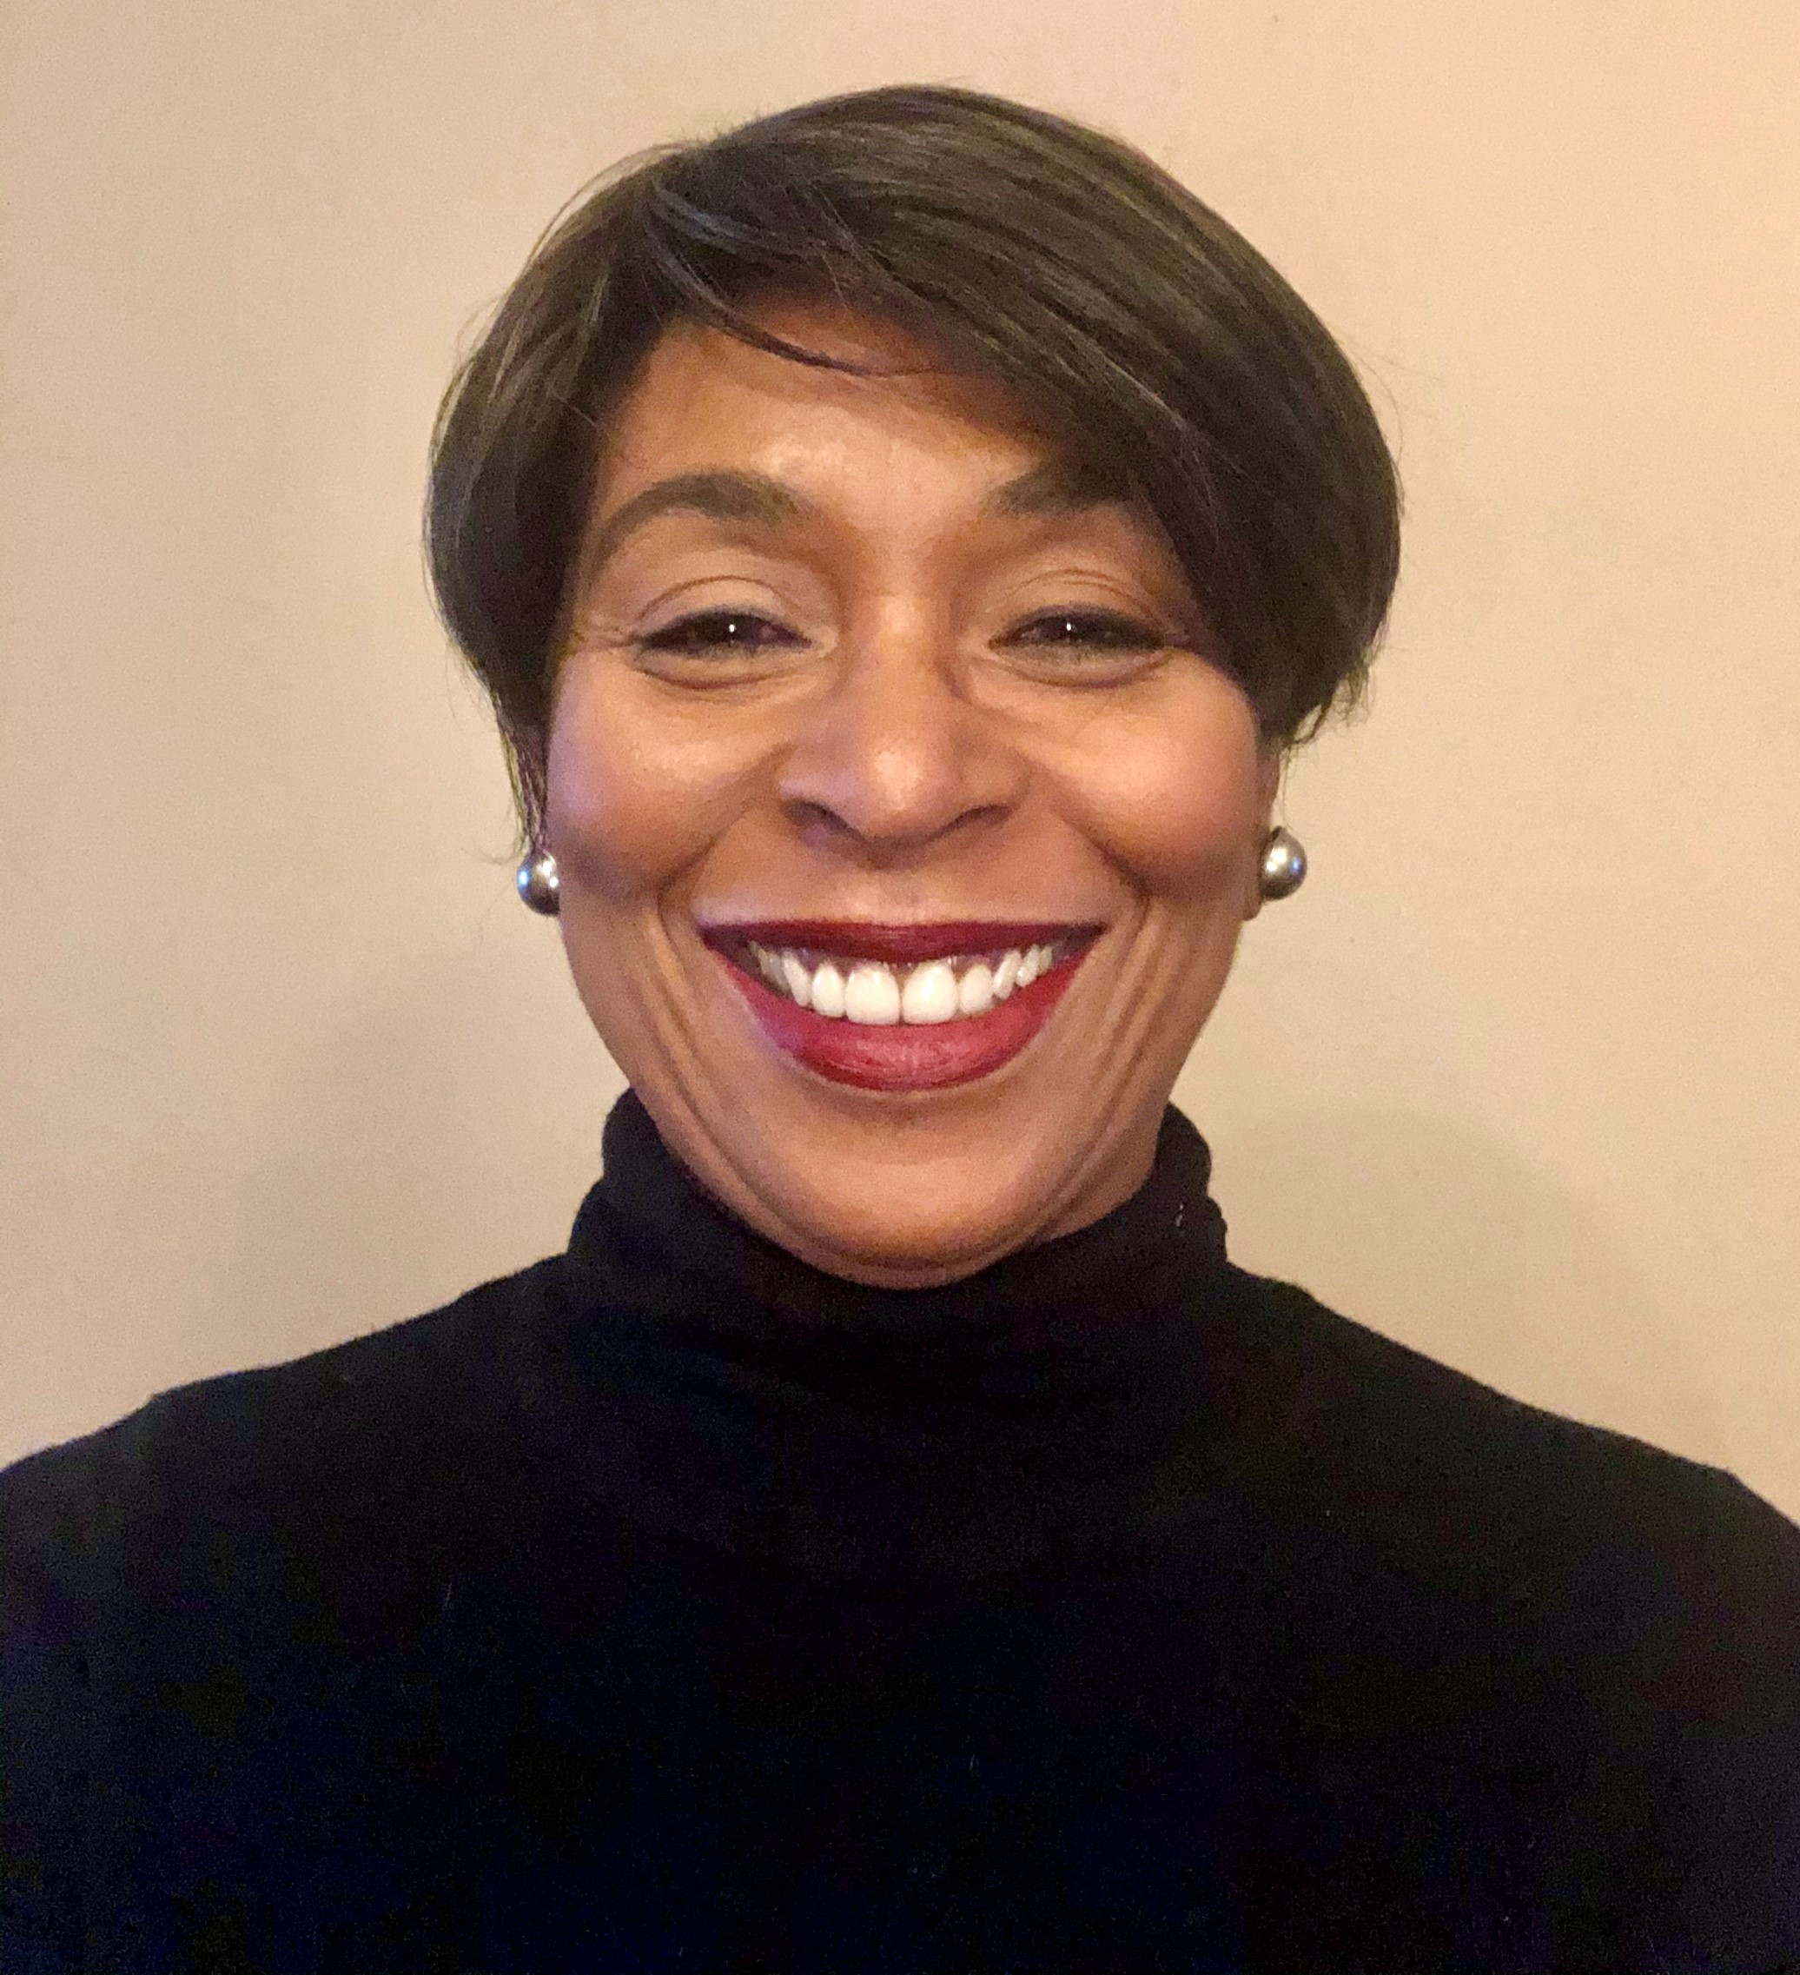
D.C. Hunger Solutions
Executive Director Beverley Wheeler, EdD.
D.C. Hunger Solutions is an initiative of the Food Research & Action Center (FRAC). We work to create a hunger-free community and improve the nutrition, health, economic security, and well-being of low-income District residents.

Slide 7
Using World Health Organization Guidance to Transform DC into an easier City in which to Grow Older
Gail Kohn, Age-Friendly DC Coordinator
Office of the Deputy Mayor for Health and Human Services
Notes:
Read slide notes for additional information.

Slide 8
DHS COVID-19 Updates
Brian Campbell
Senior Policy Advisor
D.C. Department of Human Services |Economic Security Administration

Slide 9
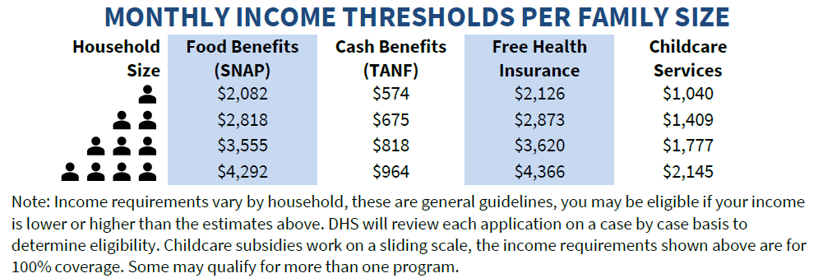
Qualifying for Public Benefits
Individuals that have lost a job, had hours reduced, or taken unplanned leave may qualify for Unemployment Insurance, Paid Sick Leave, or Workers Compensation through the DC Department of Employment Services (DOES). These benefit levels may be higher than public benefits provided through DHS and also may impact eligibility for DHS benefits. We encourage those that may be eligible to visit does.dc.gov/service/unemployment-compensation-process to learn more.
DHS Public Benefits – Monthly Income Thresholds per Family Size

Slide 10



Summary of Program Changes
 | SNAP | TANF | Medical Assistance
Certification Extensions | Auto-extended if due in March, April, May, and June | Auto-extended if due in March, April, May, and June | Auto-extended if due in March, April, May, June, and July
Mid-Certifications/Interim Contact | Waived | N/A | N/A
How to Apply | Online, mobile app, Service Center, Mail | Online, mobile app, Service Center, Mail | Online, mobile app, Service Center, Mail
Interviews | Waived (through June) | Waived (through June) | Waived (Through July)
Submitting Verifications | Online, Service Center, Mail, Email | Online, Service Center, Mail, Email | Online, Service Center, Mail, Email
Verifications | All required | All required except comprehensive assessment, orientation, and IRP | Self-attestation except Citizenship, Immigration Status, and LOC
Changes | Process as normal | Process as normal | Do not process if makes customer ineligible
Terminations | Allowed | Allowed | Not allowed except for residency, requested by customer, or death
Treatment of COVID-19 Benefits | Stimulus Checks: Excluded FPUC: Counted | Stimulus Checks: Excluded FPUC: Counted | Stimulus Checks: Excluded FPUC: Excluded
Emergency Allotments | March, April, May, June and July | N/A | N/A
FPUC = Federal Pandemic Unemployment Compensation

Slide 11


Emergency Allotments
Temporary increase in SNAP benefits for SNAP households not receiving the max allotment for their household size (~50% of DC’s SNAP caseload)
Allotment = difference between household’s certified allotment and max allotment for household size
Allotments issued for March, April, May and June
Not action is needed from customer; auto-loaded onto EBT card
Impact to DC*
$11 million
issued in SNAP Benefits
34 thousand
SNAP households
*As of 5/1

Slide 12




Application & Verification Submission
ONLINE
PICK-UP/DROP-OFF
DC Access Mobile App
MAIL
SNAP, Cash/TANF, and Non-MAGI (not LTC), Alliance and ICP: https://dcbenefits.dhs.dc.gov/
MAGI Medicaid: https://dchealthlink.com/
H Street
Congress Heights
Taylor Street
Department of Human Services
Economic Security Administration
Case Record Management Unit
P.O. Box 91560
Washington, DC 20090
https://dhs.dc.gov/dcaccess

Slide 13


SNAP Online Purchasing @ Amazon
Allows DC residents on SNAP (or P-EBT) to purchase food for delivery at Amazon.com
SNAP cannot be used to pay delivery fees
Amazon offers SNAP customers free delivery if minimum purchase is made:
  Amazon Grocery: $25 minimum for free delivery
  Amazon Fresh: $35 minimum for free delivery
  Amazon Pantry: $35 minimum for free delivery
  More info: https://amazon.com/snap-ebt
Whole Foods not included
Amazon only accepts SNAP benefits; not TANF

Slide 14
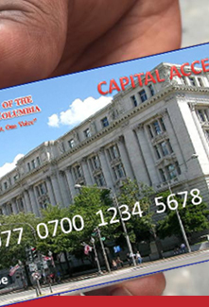
EBT Card Issuance
Receiving Your EBT Card
April 20, DHS began offering the service of mailing new and replacement EBT cards to customers. Cards are mailed to the customer's address on record with DHS by Fidelity Information Services (FIS) - the District's EBT card distribution company. Customers may expect to receive their EBT card within five to seven days, and are not required to visit the EBT Office to receive their card.
Customer's without a fixed mailing address may pick up their EBT card at one of the following EBT Card Distribution Centers:
EBT Card Distribution Center: 645 H Street NE
Hours of Operation:
Wednesday from 7:30 am – 12 noon*
Monday from 7:30 am – 4:45 pm*
Friday from 7:30 am – 4:45 pm*
EBT Card Distribution Center: 1649 Good Hope Road SE
Hours of Operation:
Tuesday from 7:30 am – 4:45 pm*
Thursday from 7:30 am – 4:45 pm*

Slide 15
Federal Stimulus Payments
IRS Economic Impact Payments (Stimulus Payments) of up to $1,200 per adult and $500 per child authorized for most U.S. Citizens. For details, see www.irs.gov/coronavirus/economic-impact-payment-information-center.
Many families with low incomes may not receive without additional action. Automatic payments only go to those that filed a tax return for 2018 or 2019; or that have Social Security retirement, disability (SSDI), survivor benefits, Supplemental Security Income (SSI) or Veterans Affairs benefits.
Portal available for anyone that isn’t filing for 2019 and may be missed at www.freefilefillableforms.com/#/fd/EconomicImpactPayment.
Additional tax-related help available through Catholic Charities – contact fsn@cc-dc.org. Individuals that worked may be eligible for Earned Income Tax Credit (EITC).
*As of 5/1

Slide 16
D.C. Hunger Solutions SNAP Outreach
www.dchunger.org/home/covid-19-food-resources
Residents with questions about their benefits or case status should contact the DHS Call Center at 202-727-5355
Residents with other questions can call D.C. Hunger Solutions at 202-640-1088 and leave a message. We will respond in 1-2 business days.
  Questions about eligibility
  Questions/assistance with process
  Resolving case problems
Applications and verification documents can be emailed to D.C. Hunger Solutions at info@dchunger.org.

Slide 17
Nutrition Programs During COVID-19
Charanya Sundar MS, RDN/LD

Slide 18

DACL Nutrition Program: Who We Are
6 Lead Agencies providing service to all 8 Wards
TERRIFIC, INC
IONA
Seabury Ward 5
Seabury Ward 6
East River Family Strengthening Ward 7
East River Family Strengthening Ward 8
46 Community Dining Sites located in all 8 Wards
  Nutritious Meals
  Nutrition Supplements
  Nutrition Education
  Nutrition Counseling

Slide 19
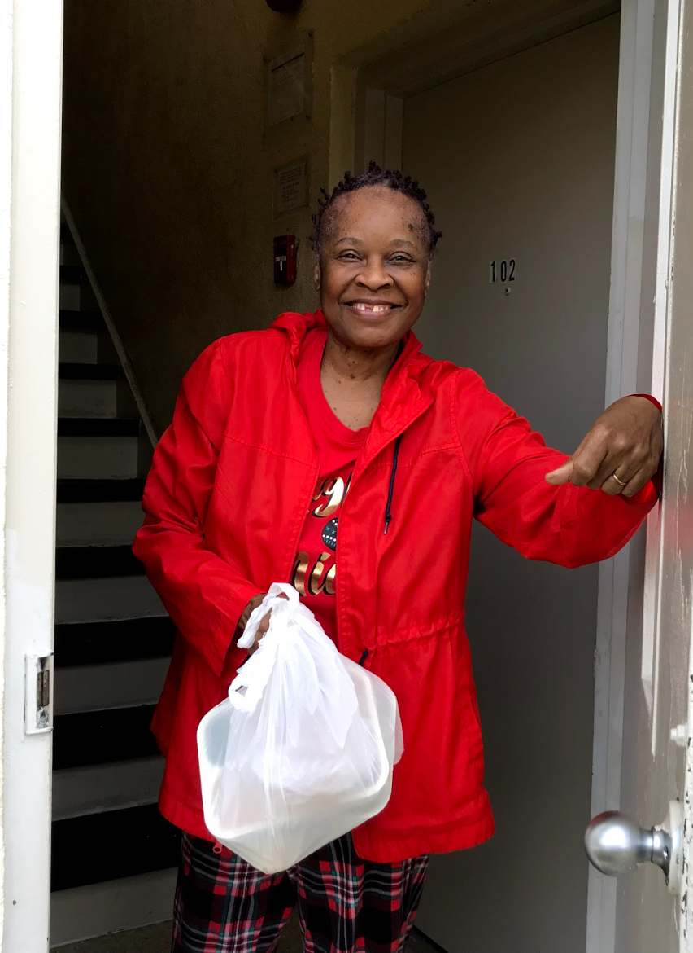
DACL Nutrition Program During COVID-19
March 16th, 2020: Congregate Dining -> Meal Pick Ups, Suspended Activities.
March 23rd, 2020: Contactless meal delivery, virtual classes and telehealth
Increased delivery 268%
451,586 meals delivered
6400+ seniors
100 seniors added weekly

Slide 20
DACL Nutrition Program COVID19
Home Delivered Meals
DC Resident 60 years of age and a congregate meal client or nutritionally high risk
7 frozen meals, juice, dairy, fruits, and bread
Regular (chicken and beef) Pureed, Vegetarian, Lactaid Milk
Shelf Stable
For more information email:
DACL.Coronavirus@dc.gov

Slide 21
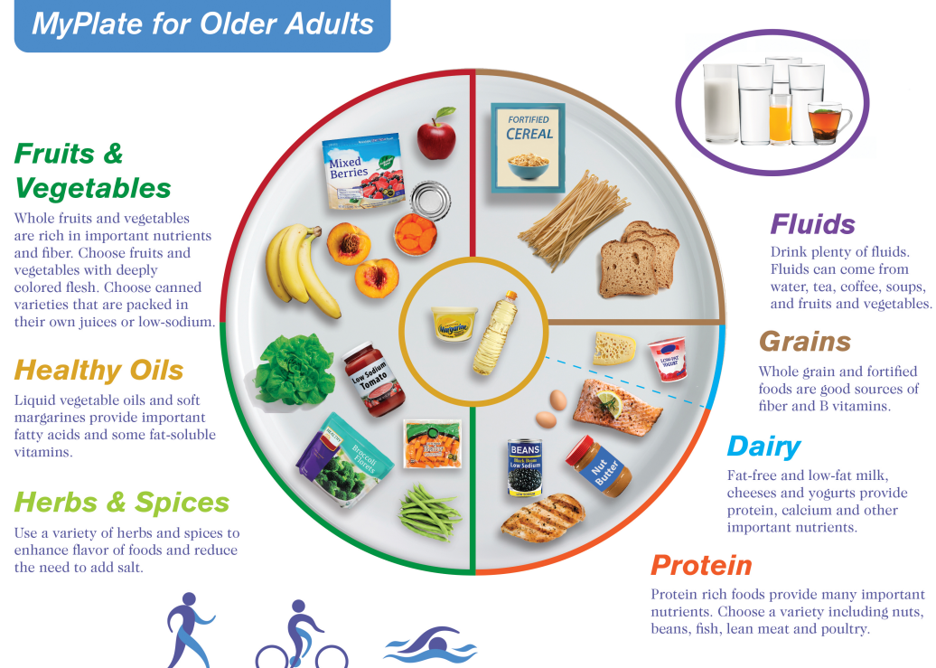
Notes:
https://hnrca.tufts.edu/myplate/myplate-for-older-adults/download/
Meals meet 1/3 of the RDA
Over 75% of adults don’t consume recommended amounts of fruits, vegetables, whole grains, and diary.

Slide 22
DACL Nutrition Program COVID19
Produce (Hungry Harvest)
DC Resident 60 years of age
Currently enrolled in SNAP or CSFP
Future: Hoping to increase produce and grocery delivery to all 8 Wards within the year
Wards 5,6,7 or 8
For more information email:
DACL.Coronavirus@dc.gov

Slide 23
How to Apply for Home Delivered Meals
Eligibility: Senior 60 and older living in DC either is a previous congregate meal client or is at nutritional risk
Call Information & Referral/Assistance: 202-724-5626 or email dacl@dc.gov. Clients will then be contacted by Lead Agency.
Emergency Clients who have limited resources and support can receive shelf stable meals within the day.
Non-emergency clients will be added within two days of approval. DACL will try to accommodate all clients as soon as possible

Slide 24
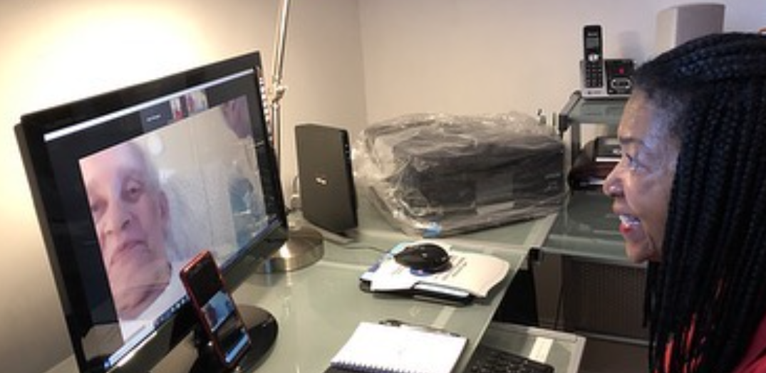
DACL Nutrition Program During COVID-19
Call and talk: 202-724-5626
Virtual Nutrition Education
Live Cooking Demonstrations
Nutrition Videos
Nutrition Discussion
Telehealth Nutrition
Website to find links and other information:
https://www.aroundtowndc.org/locations/online-activities/
District’s COVID-19 needs hotline: 1-888-349-8323 or gethelp.dc.gov to have food/essential items delivered

Slide 25

Capital Area Food Bank
Austin Hicks
Marian Peele

Slide 26
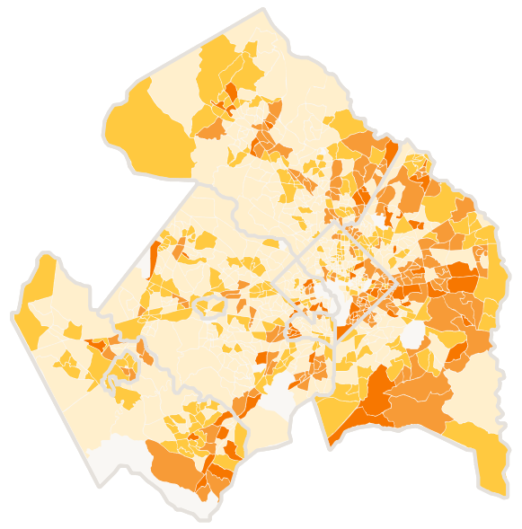
The Capital Area Food Bank
Since 1980, the Capital Area Food Bank has existed to help solve the problem of hunger in our region.
Hunger affects every age, race, religion and zip code.
Pre-COVID, we were distributing over 30 million meals worth of food to almost 400,000 food insecure individuals each year through a network of over 450 regional nonprofit partners.
  80,000 food insecure in DC
  180,000 food insecure in Maryland (Montgomery + Prince George’s Counties)
  120,000 food insecure in Northern Virginia
We anticipate that those numbers will rise significantly given pandemic impacts on the local economy.

Slide 27
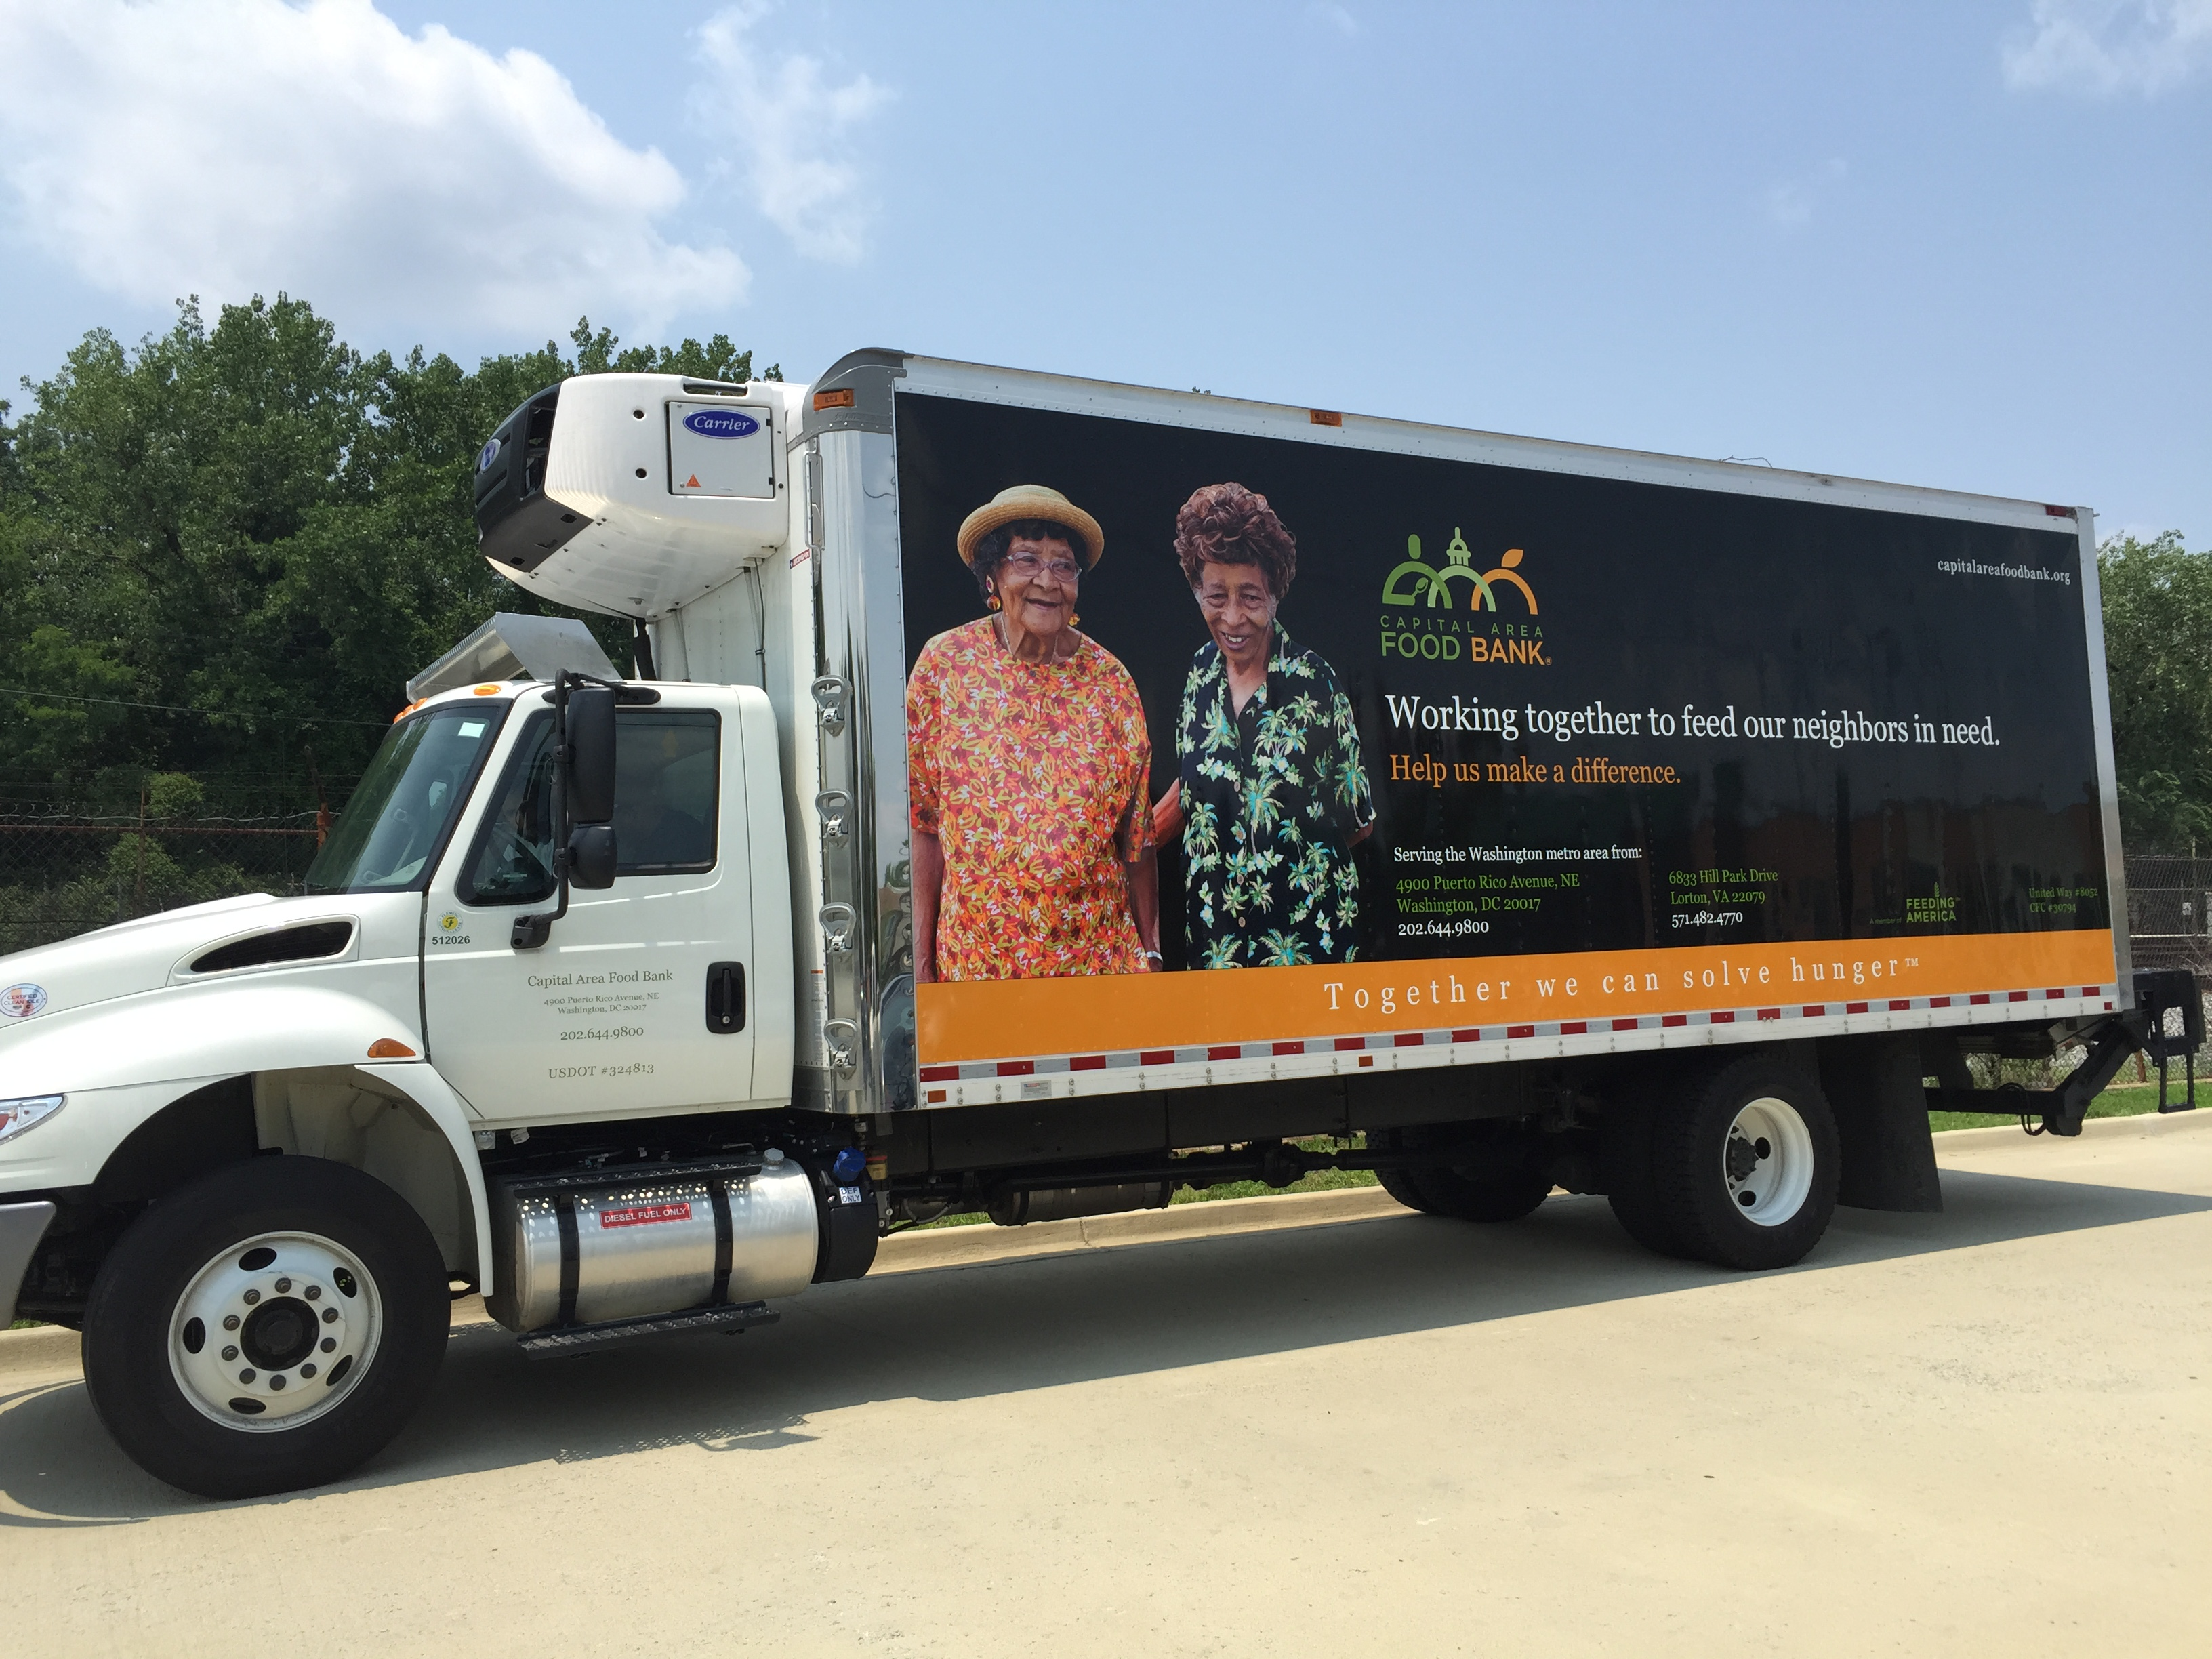
CAFB in the Time of COVID19
Hunger in Our Region
  Unemployment Claims
  Increase in request for emergency food
  Increase in calls to Hunger Lifeline
CAFB Operations
  Partner Agencies
  Decrease in Retail Donations
  Food Purchases
CAFB Response
  New Distribution Models
  Emergency Boxes
  Meal Sites for Kids

Slide 28
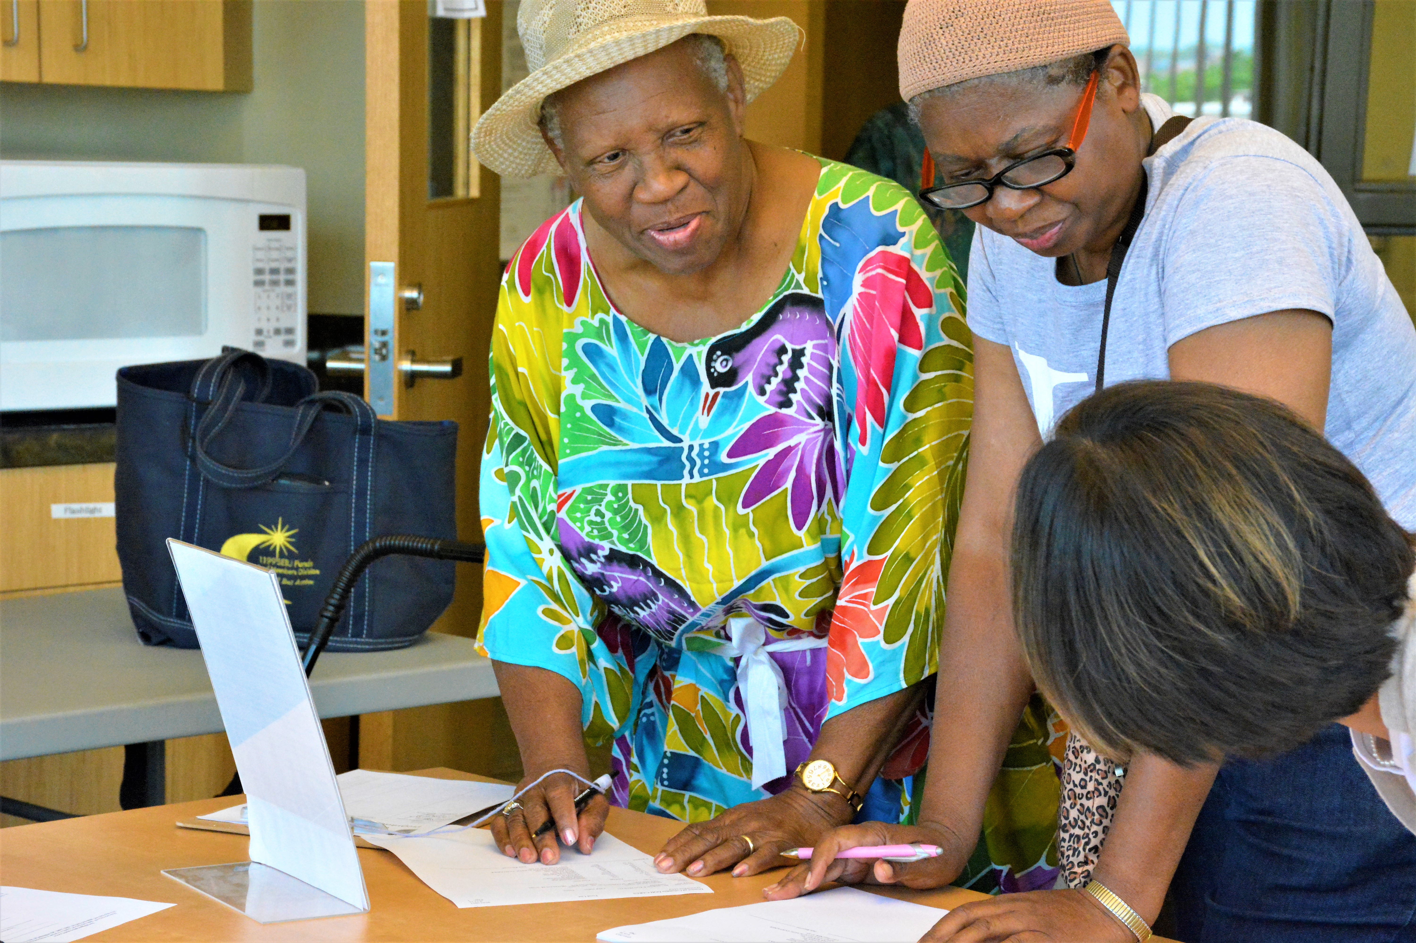

Grocery Plus
Commodity Supplemental Food Program (CSFP)
  USDA Program
  DC Residents
  60 and over
  130% of poverty
Senior Farmer’s Market Nutrition Program (SFMNP)
  Provide low-income seniors with access to locally grown fruits, vegetables, honey and herbs.

Slide 29
D.C. Food Policy Council
Food Access Programs for Seniors
Tariq Sheriff, MPH
Food Policy Analyst, D.C. Office of Planning

Slide 30
Other District food resources during COVID-19
Free groceries at school meal sites
Produce Plus Program
Home-delivered meals & groceries for residents in quarantine
Meals for residents experiencing homelessness

Slide 31
Free groceries at school meal distribution sites
12:30 pm to 2 pm; 300+ bags at each site; first come, first served
Monday
Tuesday
Wednesday
Thursday
Friday
  Brookland Middle School (Ward 5)
  Eastern Senior High School (Ward 6)
  Kelly Miller School (Ward 7)
  Stanton Elementary School (Ward 8)
  Columbia Heights Education Campus (Ward 1)
  Coolidge/ Wells (Ward 4)
  Woodson High School (Ward 7)
  Turner Elementary School (Ward 8)
  Anacostia High School (Ward 8)
  Kimball Elementary School (Ward 7)
  Bard High School (Ward 7)
  Ballou High School (Ward 8)
  Columbia Heights Education Campus (Ward 1)

Slide 32
Resources for residents in isolation and self-quarantine
Residents who have tested positive for COVID-19, directed to self-quarantine by a medical provider, or showing symptoms and need help accessing food or other resources
Home-delivered meals (21 meals)
Home-delivered groceries (7 days)
Other supplies (hygiene and pediatric)
Call 1-888-349-8323
Visit: gethelp.dc.gov

Slide 33
Meals for residents experiencing homelessness
All shelters are open 24/7 and provide 3 meals per day for clients
Daily meals for unsheltered individuals are provided at various distribution points
Outreach teams are delivering 400+ meals daily to unsheltered individuals
For more information email:
dhs.covid19@dc.gov

Slide 34

Produce Plus Direct
2020 version of the Produce Plus program administered by DC Greens and funded by DC Health
Provides locally grown fresh produce to DC residents in areas with limited access to fresh, healthy food
The program is free to DC residents
Operates from July 14 – September 30, enrollment start June 23
For more information and to signup visit: dcgreens.org/customers
Call: (202) 888-4834
Notes:
Is designed to support safe access to the program benefits during the COVID-19 pandemic

Slide 35
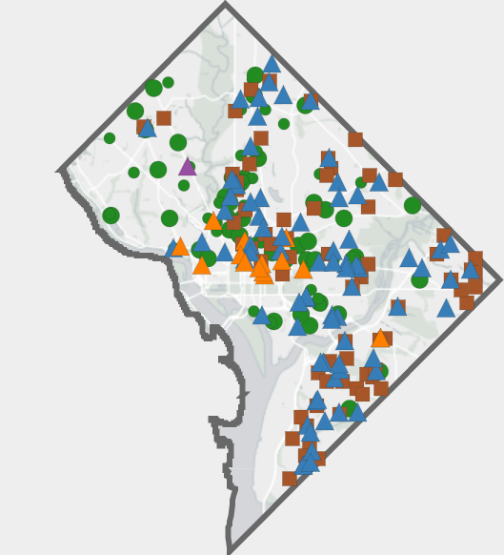
How to find these additional food resources
Find the District’s food resource map and more details on coronavirus.dc.gov/food
Hotline for isolation: 1-888-349-8323 or visit gethelp.dc.gov
Questions? Email dcfoodpolicy@dc.gov

Slide 36

Questions?

